Slide 1
CELS Management System
> By Peaky Blinders

Slide 2
H G L S Nawarathna
Project Manager
Our
Team
Layout
H E A I Jayawardhana
Programmer
N M V S Nawarathna
Database Manager
Y M L D K Yapa
UI Designer

Slide 3
Agenda Style
01. Introduction.
02. Product Perspective.
03. Product Functions.
04. User Classes and Characteristics.
05. Operating Environment.
06. Interfaces.
07. System Functional Features.
08. Database Requirements.
09. Use Case Description.
10. References.

Slide 4
Introduction.
Cambridge English Language School is an institute which is doing their institute management manually.
Purpose of project is to build computer-based system which can do management. By this system
institute can manage their process soon and well.
Purpose of this SRS to maintain good continue of the developing system and identify the every requirement that need to develop the system.
CELS management system has features to manage students, classes, staff, exams, documents,
transactions and announcements.
It also let users to provide their service more efficiently to students.
The system is based on a relational database with this institute management.

Slide 5
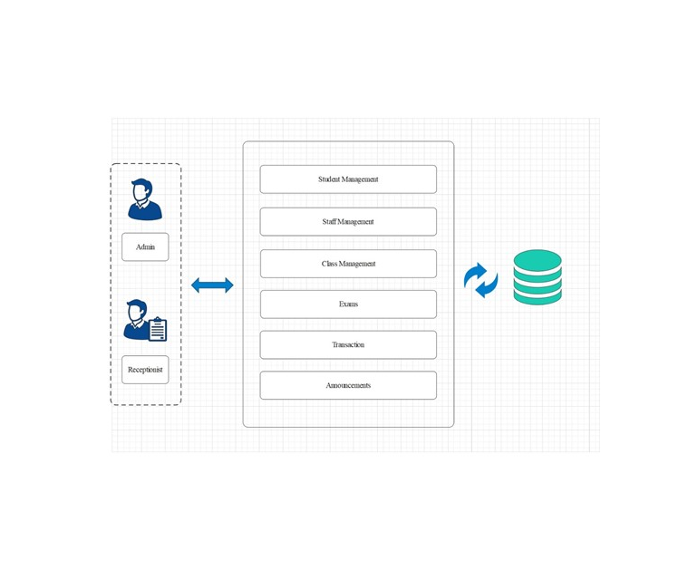
Product perspective
Product is a computer-based system which connected with the database.
This system has two entities
One is Admin other one is User
PowerPoint Presentation

Slide 6
Product functions.
Student Management
Class Management
Staff Management
Exam Management
Document Management
Transaction Management
Announcement Management

Slide 7
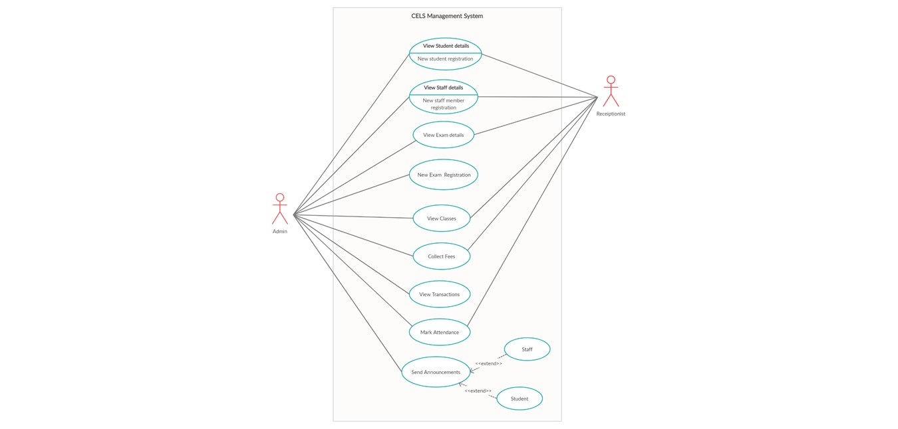
User classes and characteristics
Administrator
User
Administrator can
manage all the things in
the system without any
boundary.
User can manage all
the things except some
things. That means
user have some
boundaries than the
administrator

Slide 8
Operating Environment
The product will operate with the Windows 7 or above version of the windows. As well as there is a special need of Microsoft SQL Server management studio 2019. PC must have at least below featured to run the product smoothly and to get better experience.
4GB RAM
500GB Hard drive
Intel dual core processor
Keyboard
Mouse
Monitor

Slide 9
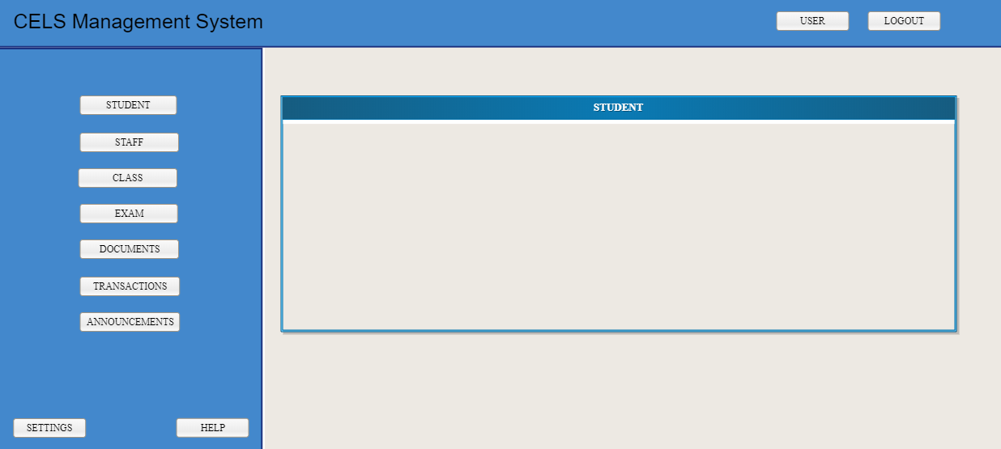
Interfaces.
Home screen.
Student management interface
Staff management interface
Class management interface
Exam management interface
Document management interface
Transaction management interface
Announcement management
interface
Login interface
Software interface

Slide 10

System functional features
View Student
View Staff
View Exam
View Classes
New Exam Registration
View Classes
Collect fees
Mark Attendance

Slide 11
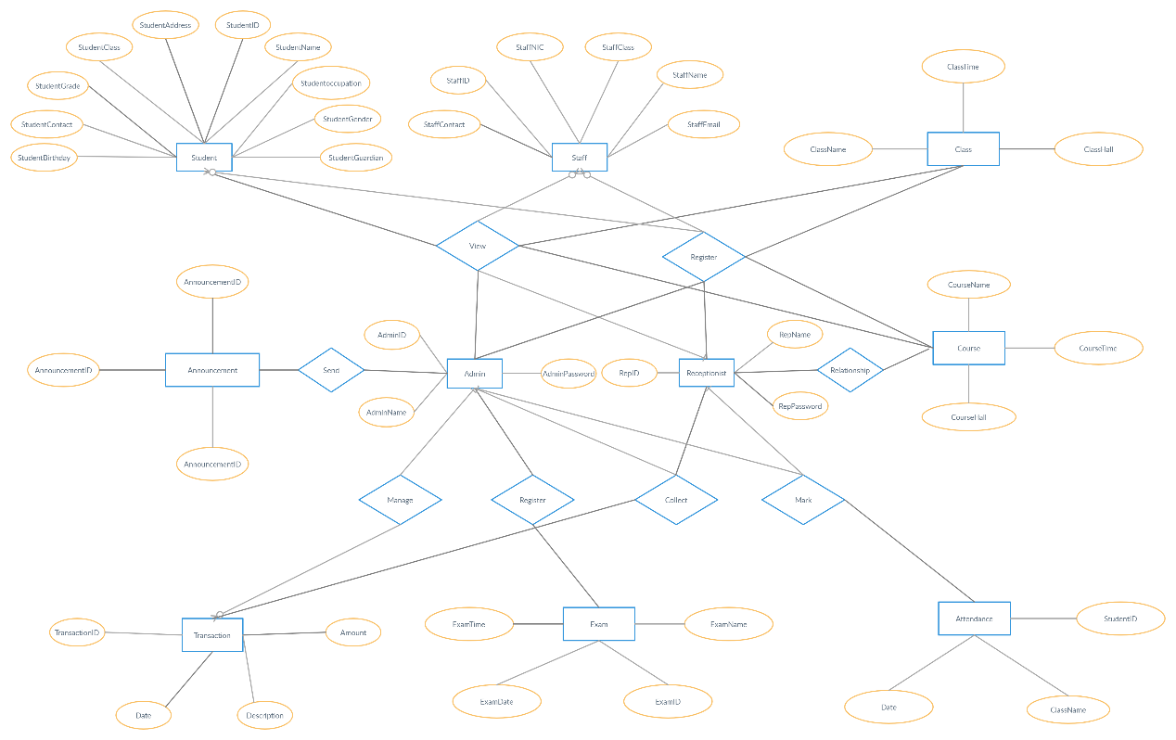
Database Requirement
According to our requirements our system will need about 10GB for the database.
We need to install the
Microsoft SQL Server
Management Studio 18 to
the computer.
We create our database with the use of following E-R Diagram

Slide 12

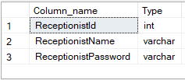
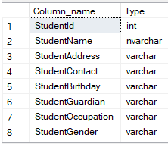
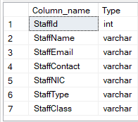
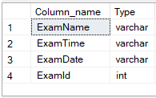
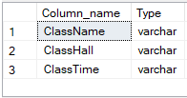
1. Admin Table
2. Receptionist Table
3. Student Table
4. Staff Table
5. Exam Table
6. Class Table

Slide 13
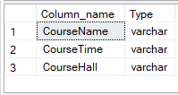
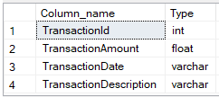
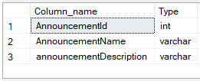
7. Course Table
8. Transaction Table
6. Announcement Table

Slide 14

NON-Functional Requirement
Performance Requirements
Safety Requirements
Security Requirements
Software Quality Attributes

Slide 15
System functional features
View Student.
Easy to change colors.
Easy to change colors.
You can simply impress your audience and add a unique zing and appeal to your Presentations.
Option A
Option B
Option C

Slide 16
References
https://www.free-powerpoint-templates-design.com/water-colored-splashes-powerpoint-template/

Slide 17
Thank you

